Slide 1
Kevin Winter Data Anonymization / Replication using Generative Models (Master’s Project)

Slide 2
Motivation & Goal
Anonymization / Replication is necessary for
Privacy
Data augmentation
Goal
Introduction of a data replication framework
Analyze key characteristics of data set
Generate data set that replicates these
Anonymization of discrete data set

Slide 3
Data Replication Framework
CRISP-DM [1]

Slide 4
Data Input
MNIST handwritten digit database [2]
Boston Housing Data [3]
Adult Income Dataset [4]
Binary Dataset

Slide 5
Data Preprocessing
Encoding
Especially for discrete variables
Continous (Reordering)
Binary
Scaling
Define range (e.g. [0,1], [-1,1])

Slide 6
Modelling & Sampling
Modelling algorithms
Gaussian Mixture Models (GMM)
Restricted Boltzmann Machines (RBM)
Variational Autoencoders (VAE)
Generative-Adversarial Networks (GAN)
Sampling from distribution / latent space

Slide 7
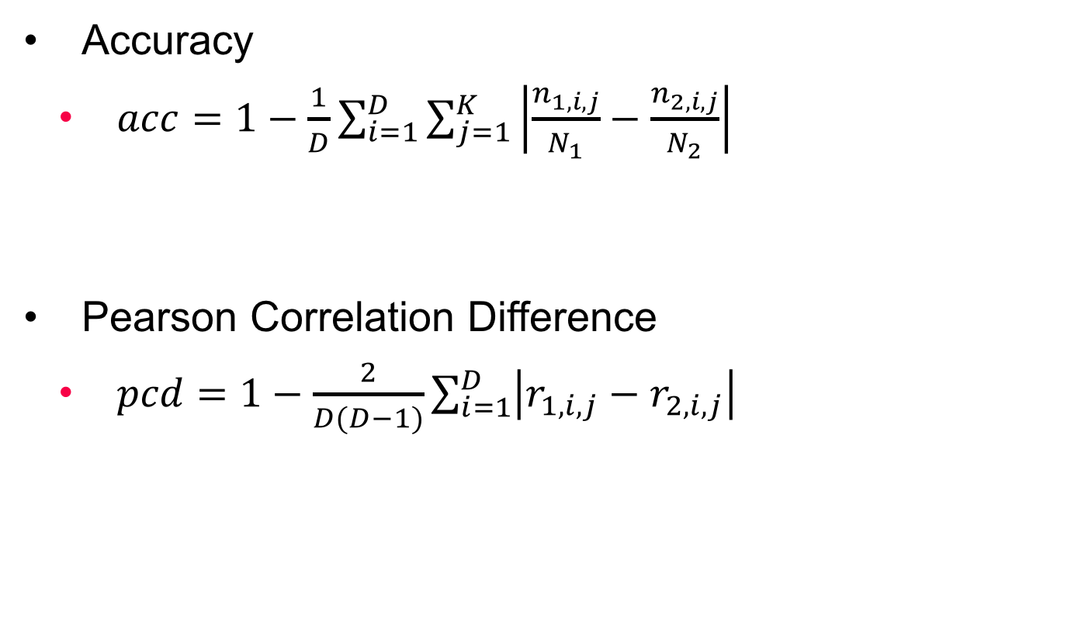
Evaluation
Accuracy
$acc=1−\frac{1}{D}\sum_{i=1}^{D}{\sum_{j=1}^{K}{\left|\frac{n_{1,i,j}}{N_{1}}−\frac{n_{2,i,j}}{N_{2}}\right|}}$
Pearson Correlation Difference
$pcd=1−\frac{2}{D(D−1)}\sum_{i=1}^{D}{\left|r_{1,i,j}−r_{2,i,j}\right|}$

Slide 8
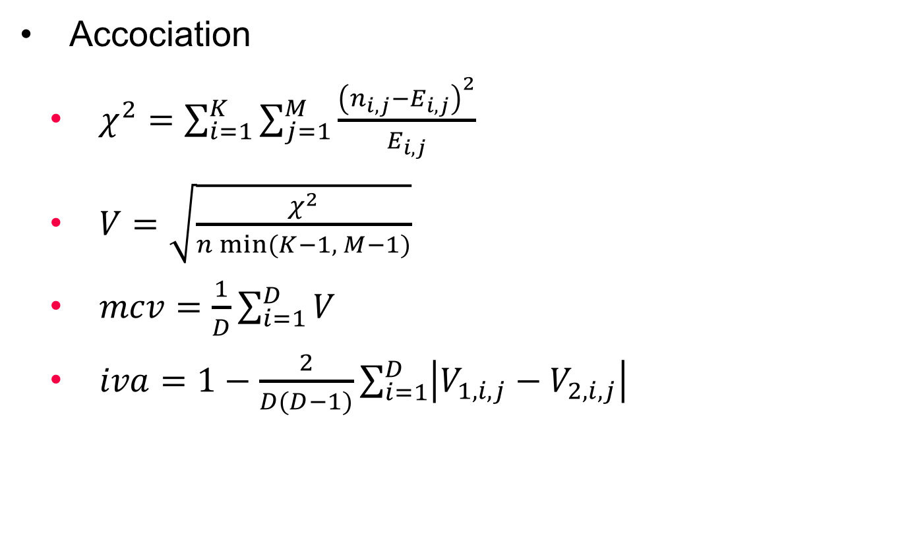
Evaluation
Accociation
$χ^{2}=\sum_{i=1}^{K}{\sum_{j=1}^{M}{\frac{{\left(n_{i,j}−E_{i,j}\right)}^{2}}{E_{i,j}}}}$
$V=\sqrt{\frac{χ^{2}}{n min⁡(K−1, M−1)}}$
$mcv=\frac{1}{D}\sum_{i=1}^{D}{V}$
$iva=1−\frac{2}{D(D−1)}\sum_{i=1}^{D}{\left|V_{1,i,j}−V_{2,i,j}\right|}$

Slide 9
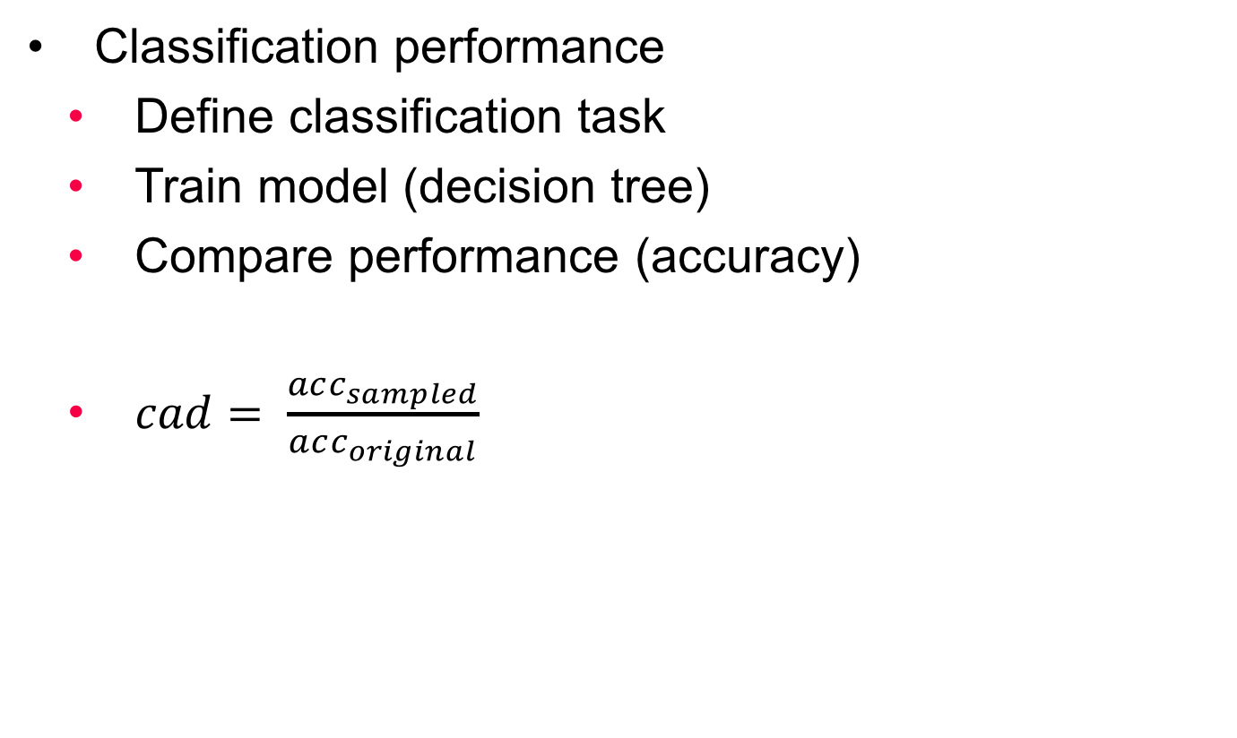
Evaluation
Classification performance
Define classification task
Train model (decision tree)
Compare performance (accuracy)
$cad= \frac{acc_{sampled}}{acc_{original}}$

Slide 10
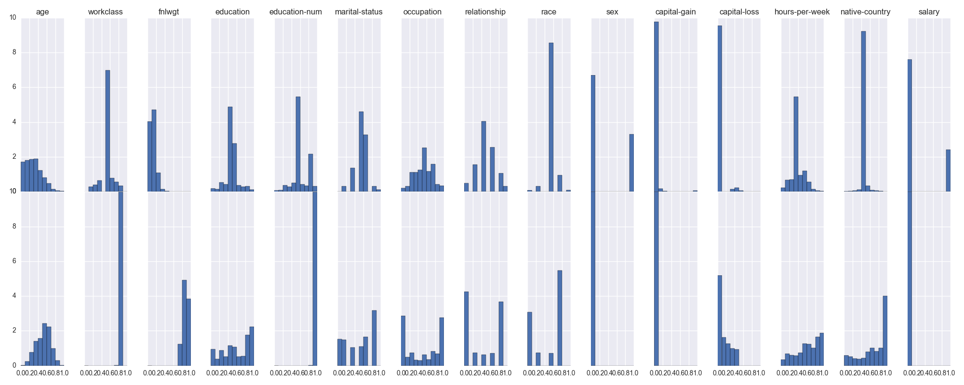
Results
GAN (reordered)

Slide 11
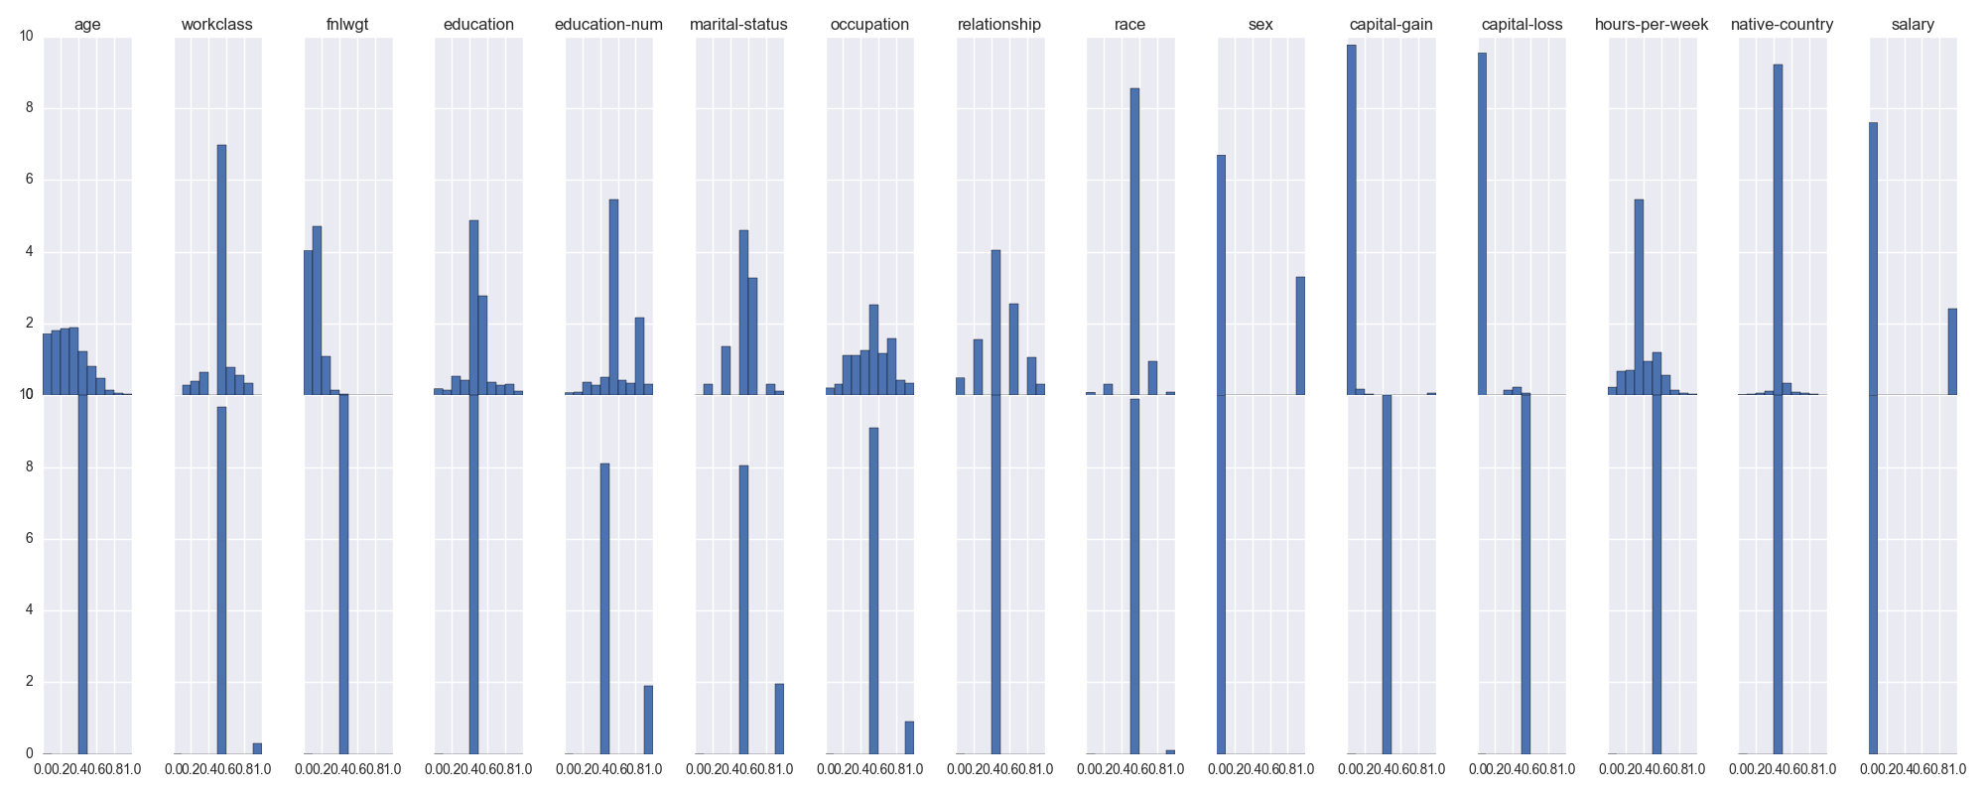
Results
RBM (reordered)

Slide 12
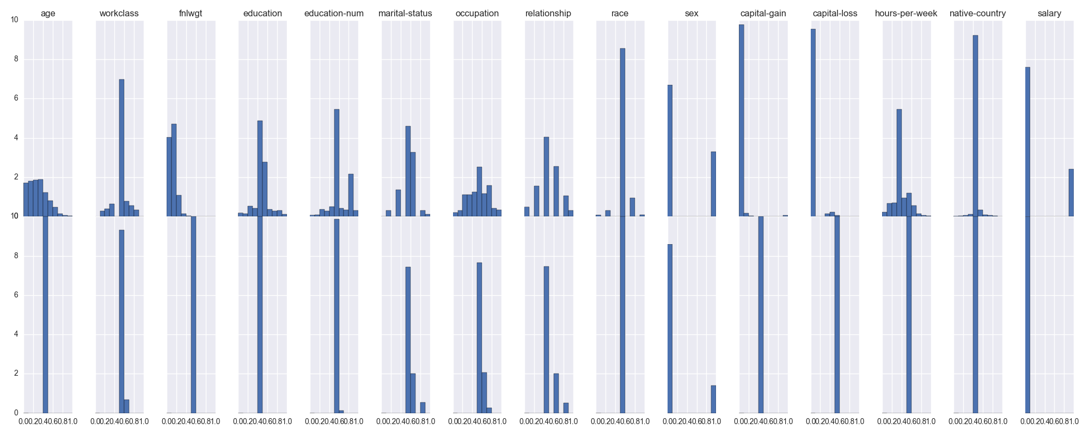
Results
VAE (reordered)

Slide 13
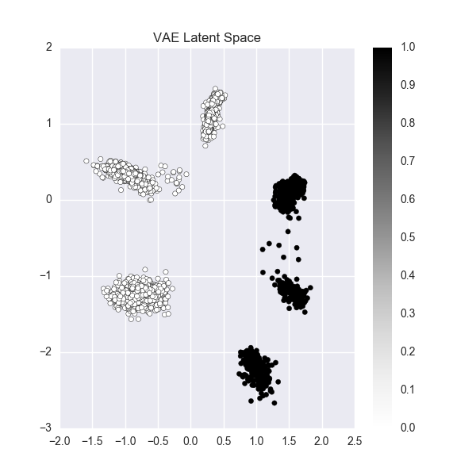
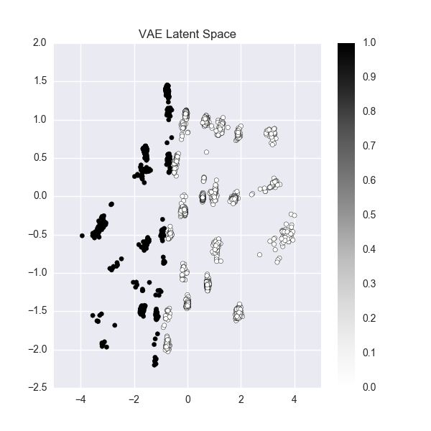
VAE Latent Space

Slide 14
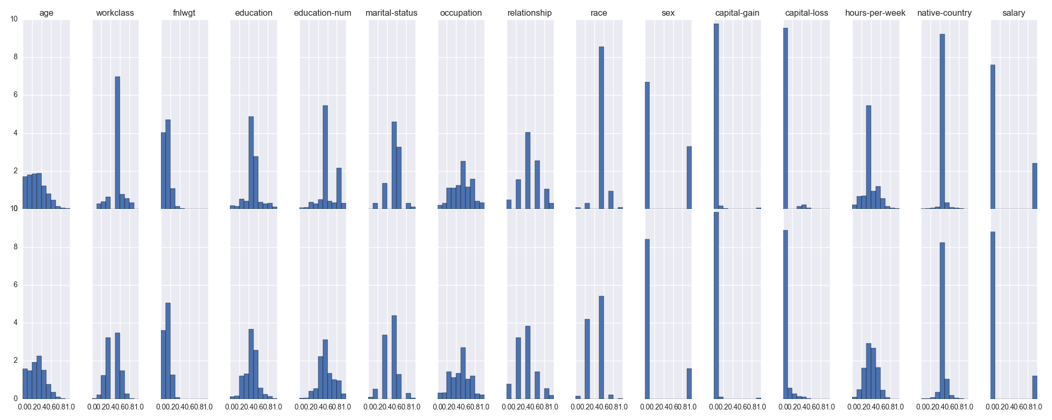
Results
GMM (reordered)

Slide 15
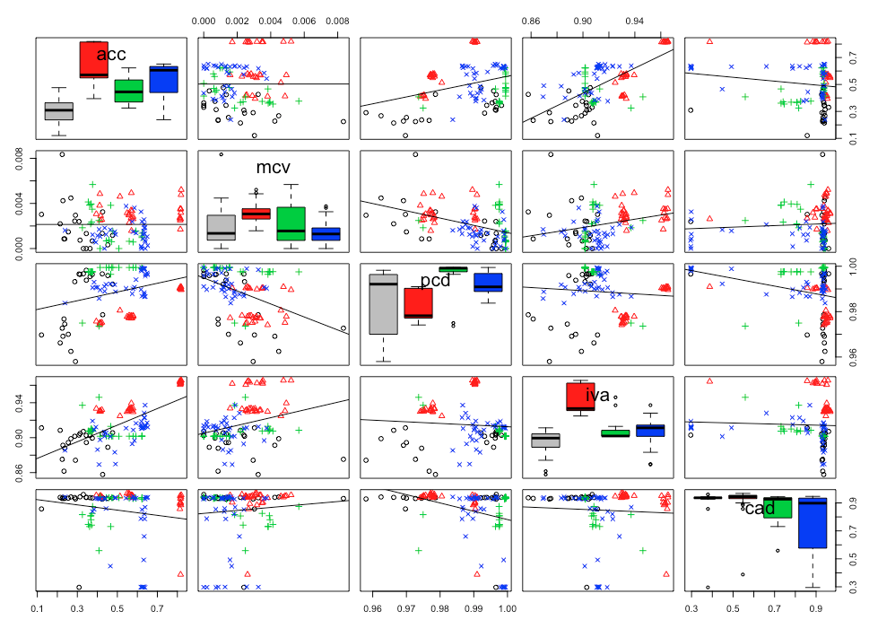
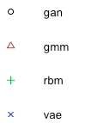
Results

Slide 16
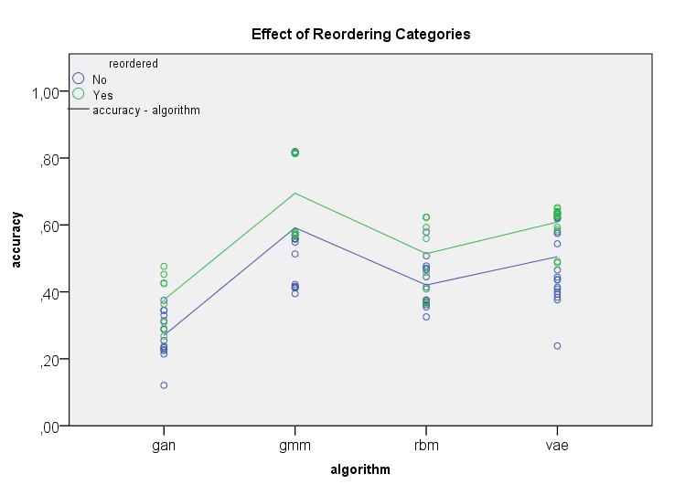
Effect of Reordering

Slide 17
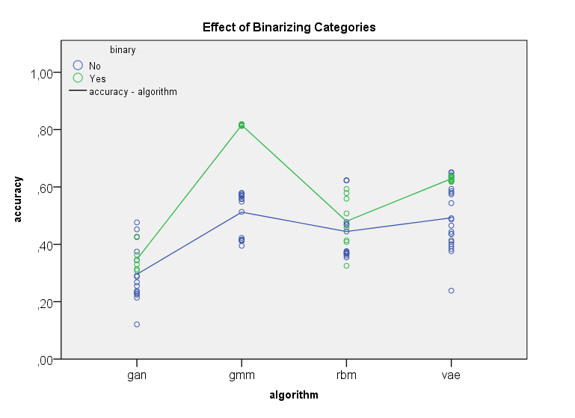
Effect of Binarizing

Slide 18
ANOVA Results for Accuracy
 | Df | Sum Sq | Mean Sq | F value | Pr(>F)
algorithm | 5 | 1,507 | 0,301 | 52,815 | < 2.2e-16 | ***
binary | 1 | 0,535 | 0,535 | 93,862 | 0,000 | ***
reordered | 1 | 0,193 | 0,193 | 33,775 | 0,000 | ***
algorithm:binary | 3 | 0,269 | 0,090 | 15,697 | 0,000 | ***
algorithm:reordered | 4 | 0,016 | 0,004 | 0,712 | 0,586
binary:reordered | 1 | 0,068 | 0,068 | 11,900 | 0,001 | ***
algorithm:binary:reordered | 3 | 0,007 | 0,002 | 0,422 | 0,738
Residuals | 96 | 0,548 | 0,006

Slide 19
Conclusion
Framework works and can be adapted easily
Data transformation is crucial
Replication of discrete data is cumbersome
Simple algorithms limited
Complex algorithms hard to train

Slide 20
References
[1] Shearer, C. (2000). The CRISP-DM model: the new blueprint for data mining, J Data Warehousing; 5:13—22.
[2] LeCun, Y. (1998). The MNIST database of handwritten digits. http://yann. lecun. com/exdb/mnist/.
[3] https://www.cs.toronto.edu/~delve/data/boston/bostonDetail.html
[4] https://archive.ics.uci.edu/ml/datasets/adult

